Slide 1
Time Series Forecasting

Slide 2
Objectives
Definition of time series
Forecasting
Seasonality
Naive forecasting
Performance Evaluation
Mean Absolute Error (MAE), Mean Absolute Percentage Error (MAPE), Mean Squared Error (MSE)
Long-Term Patterns
Moving Average Models
Autoregressive Moving Average (ARMA)
Autoregressive Integrated Moving Average (ARIMA)
Seasonal ARIMA (SARIMA)
Recurrent Neural Networks (RNN)
Recurrent Neuron, Recurrent Layer and Recurrent Architectures
Backpropagation Through Time (BPTT)
Deep RNN
Multivariate Input
Forecasting Several Steps Ahead
Recursive multi-step forecasting
Direct multi-step forecasting
Sequence-to-sequence forecasting
Handling Long Sequences
Exploding Gradients Problem
Short-Term Memory Problem (LSTM, GRU)
WaveNet

Slide 3
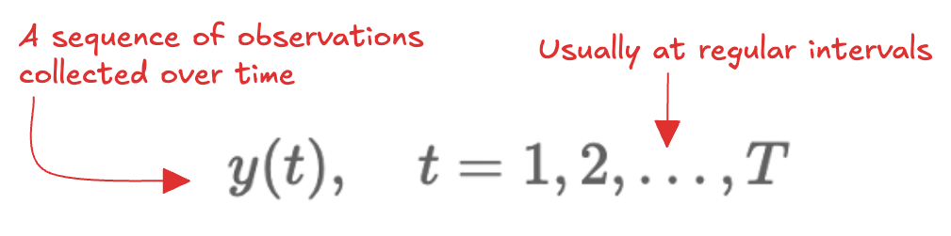
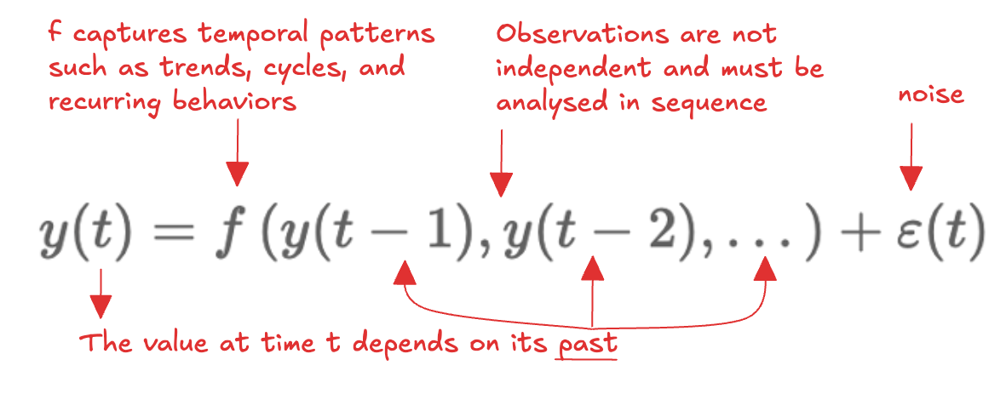
Definition of time serie
Examples:
Daily active users on a website
Hourly temperature in a city
Daily household energy consumption
Temporal ordering matters
Why time series analysis? Learn from past data (trends, seasonality, cycles)

Slide 4

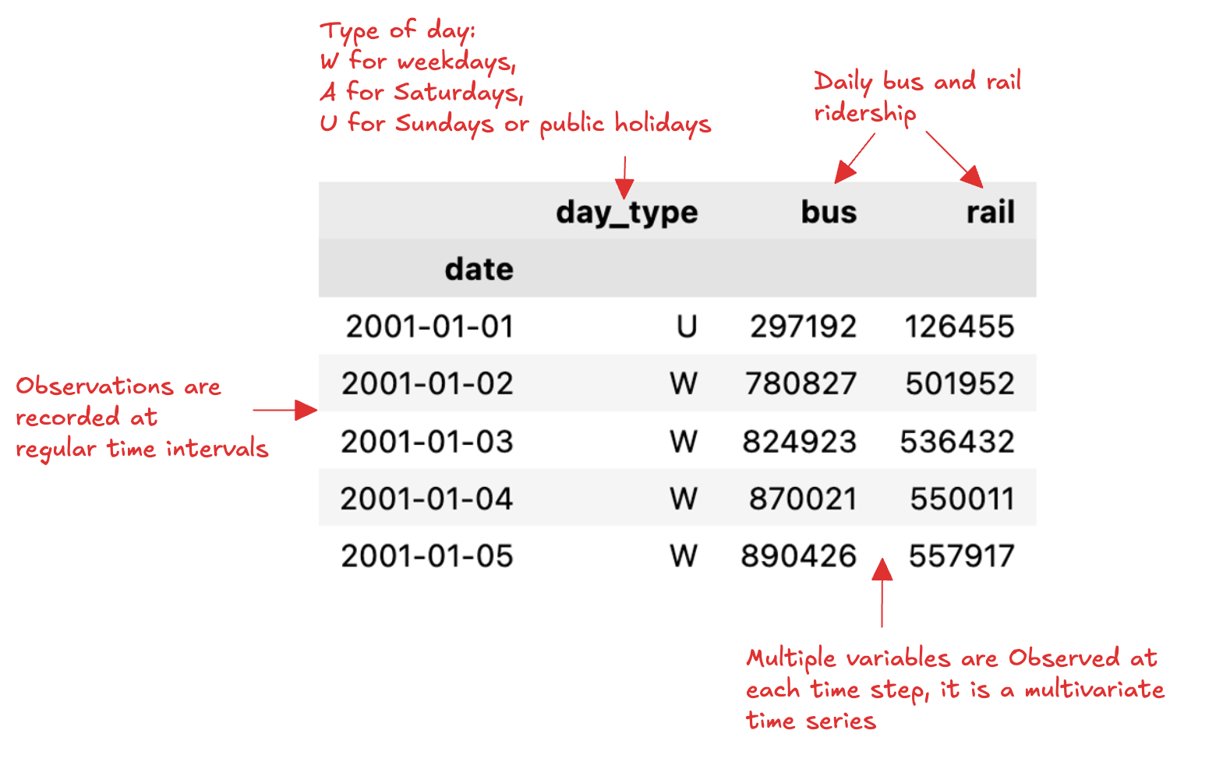
Chicago Transit Authority Dataset
Example

Slide 5
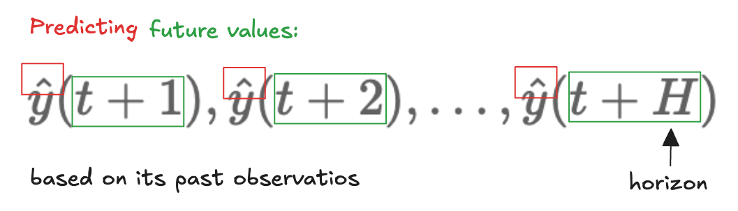
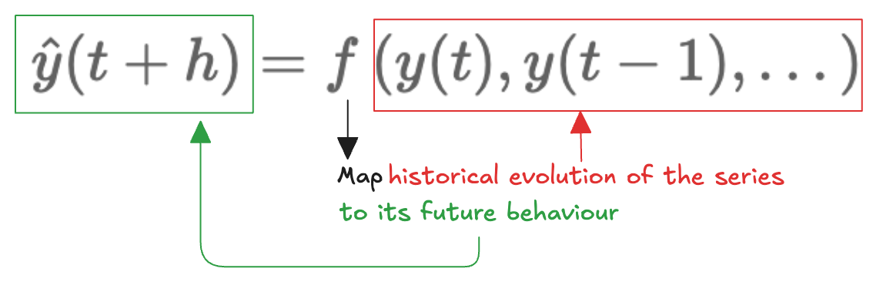
Forecasting
Learn a function:
Assumption underlying temporal patterns remain stable!
Given the observed ridership up to today…
…forecast tomorrow’s demand or the ridership over the next week
Applications:
Operational planning
Resource allocation
Service optimization

Slide 6
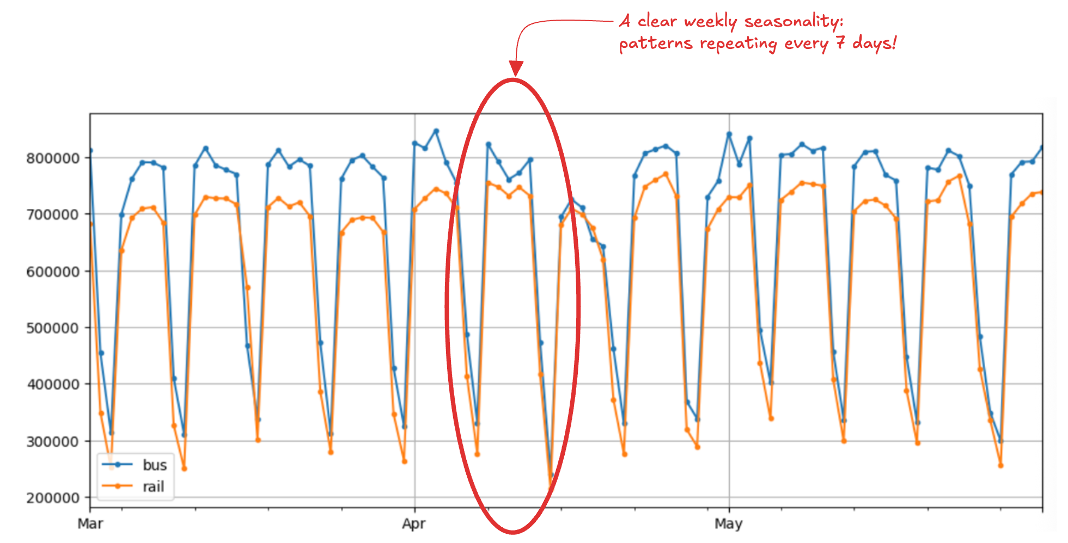
Seasonality
Plot of the ridership over few months in 2019

Slide 7
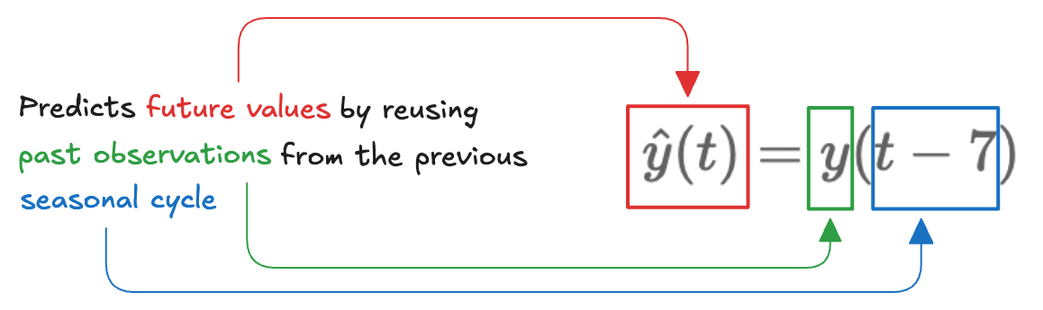
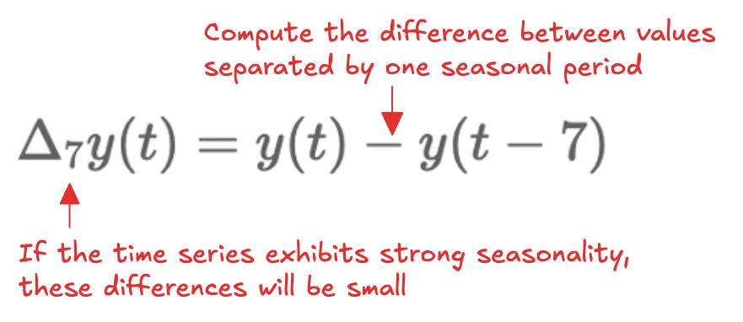
Naive forecasting
Simple, yet often a strong baseline
Make seasonality visible:
The Pandas diff() method computes the difference between each observation and the value recorded a specified number of periods earlier

Slide 8
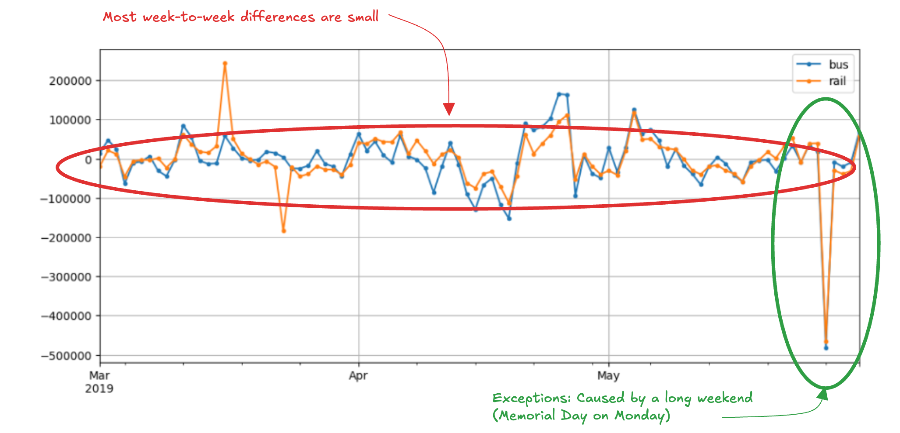
Autocorrelation
Readership shows strong weekly pattern
When a series is strongly correlated with a time-shifted version of itself, it exhibits autocorrelation

Slide 9
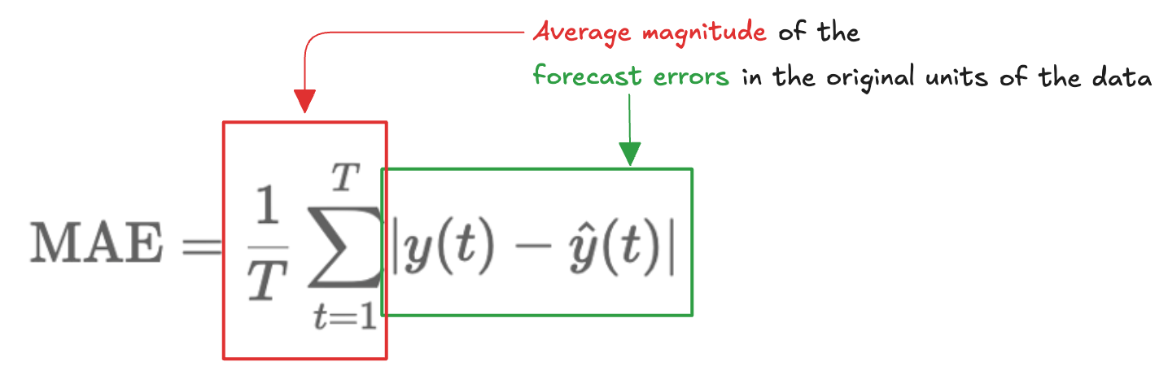
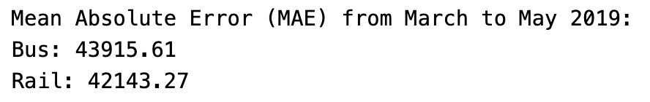
Mean Absolute Error (MAE)
Quantitative assessment
How far the predictions are, on average, from the true observations:
Absolute errors are hard to interpret (large or small?):

Slide 10
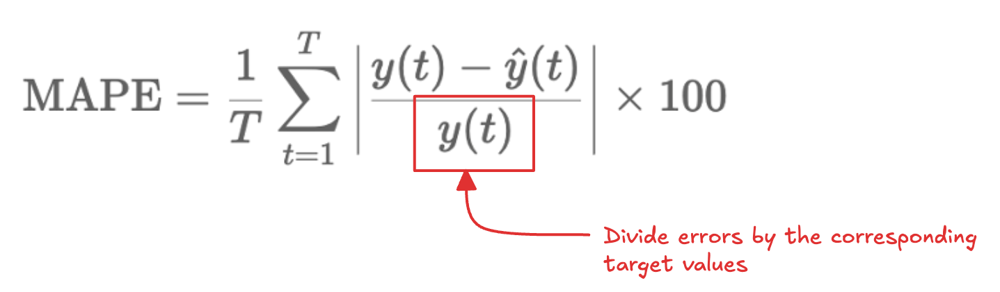
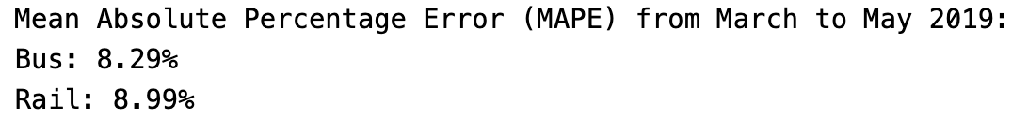
Mean Absolute Percentage Error (MAPE)
We can normalize by the true values:
Relative errors show that bus forecasts are slightly more accurate
Bus ridership volumes are higher → larger absolute errors

Slide 11
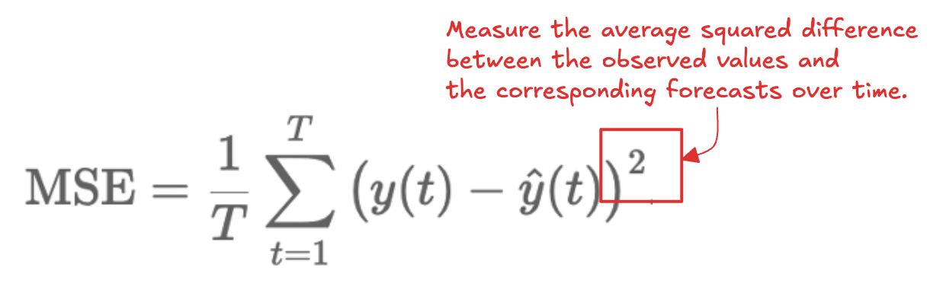
Mean Squared Error (MSE)
Penalize large forecast errors heavily than small ones
Particularly sensitive to outliers and abrupt deviations
Useful when large errors are especially undesirable
Metric choice depends on the task and data scale

Slide 12
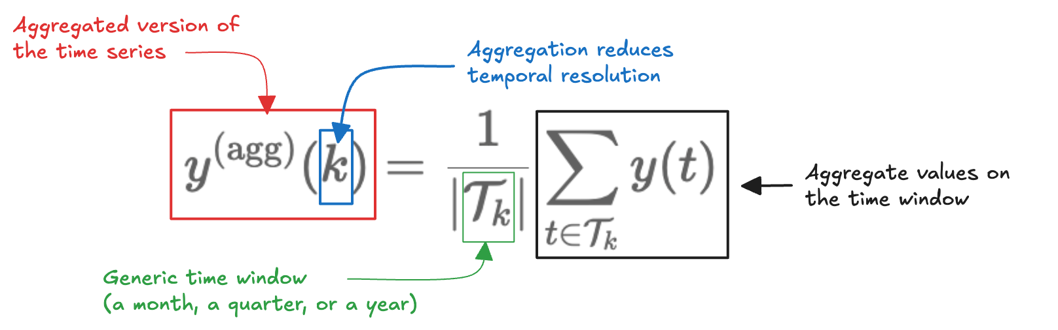
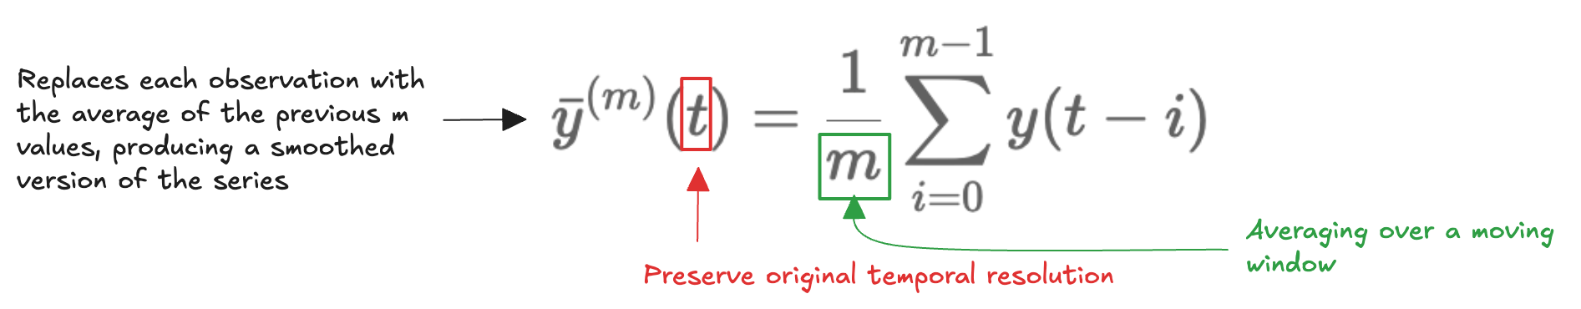
Long-Term Patterns (1)
Difficult to identify clear trends beyond the strong weekly seasonality
We can analyse at different temporal scales by aggregating:
Aggregation can obscure how patterns evolve, we use rolling statistics
Pandas resample() and rolling() methods

Slide 13
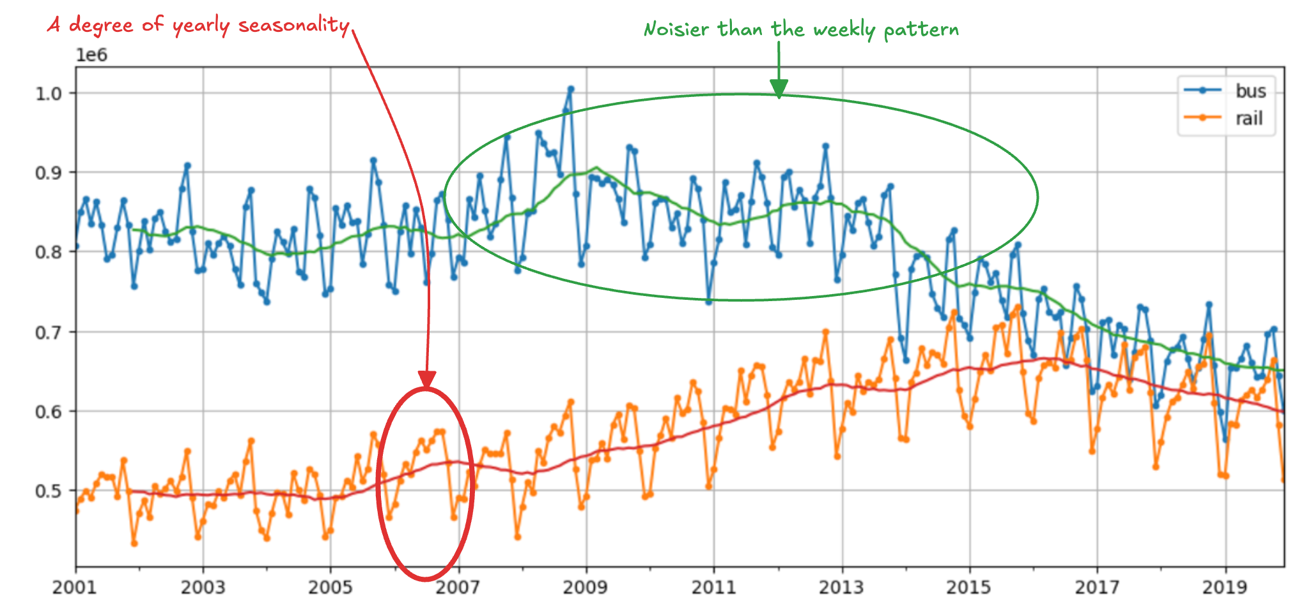
Long-Term Patterns (2)
Analyse data from 2001 to 2019 both the monthly aggregated series and its 12-month rolling average

Slide 14
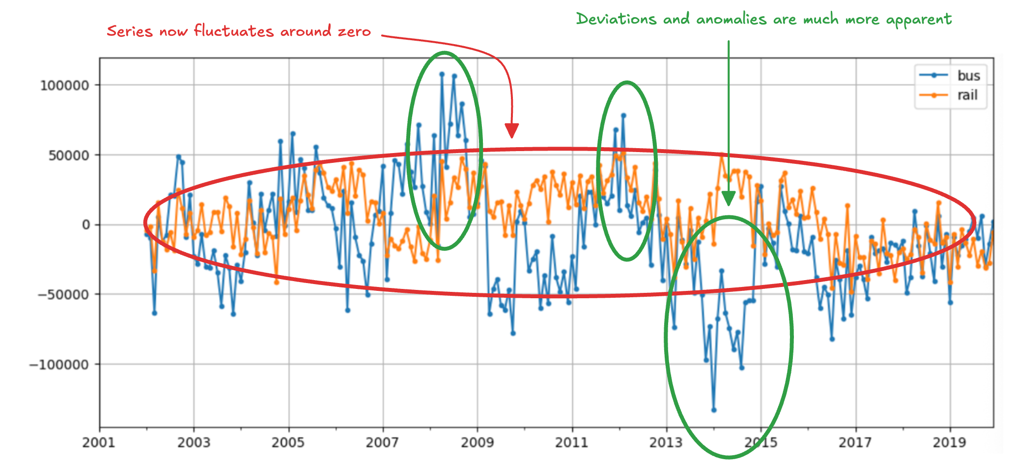
Long-Term Patterns (3)
Applying a 12-month differencing:

Slide 15
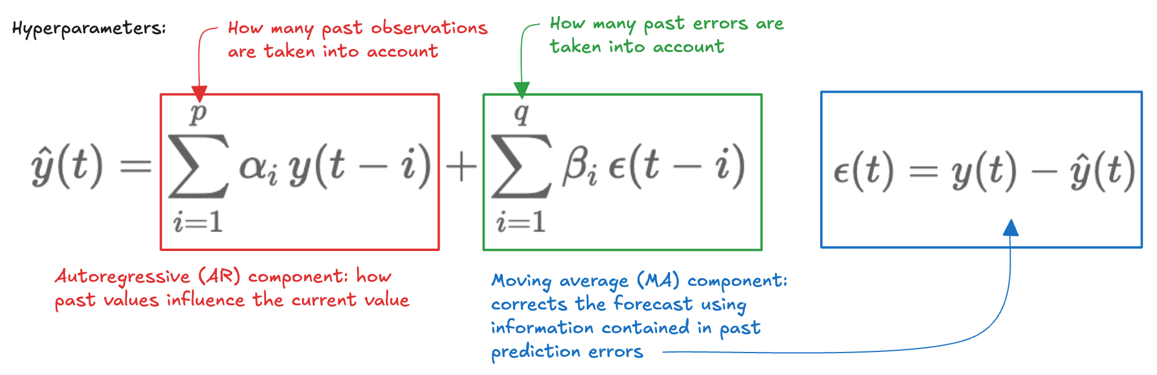
Autoregressive Moving Average (ARMA) (1)
Combines past values and past forecast errors
Balanc
Parameters alpha and beta are fitted to data, using methods like maximum likelihood estimation
Hyperparameters p and q determine how many past observations and past errors are considered
How do we choose p and q?

Slide 16
Autoregressive Moving Average (ARMA) (2)
Start with small values of p and q
Fit the model and estimate the parameters
Examine the residual diagnostics
If residuals resemble white noise, the model is adequate
If systematic patterns remain, increase p and/or q
If added complexity brings no improvement, further parameters may cause overfitting
Balance model expressiveness (ability to capture temporal dependencies) and parsimony (keeping the model as simple as possible)

Slide 17
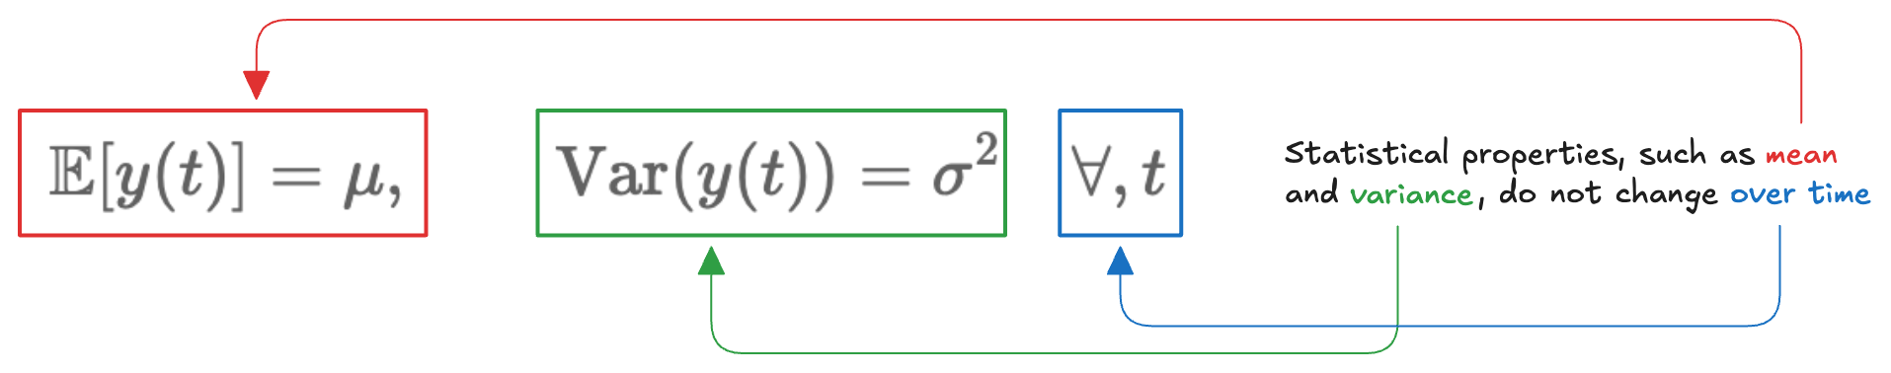
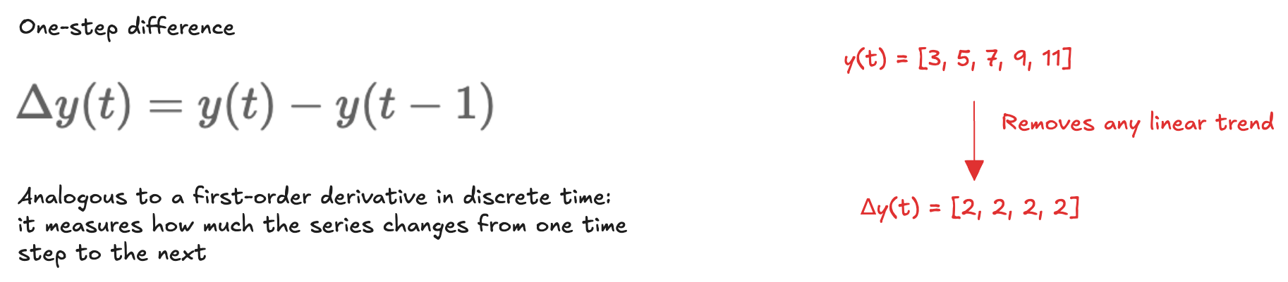
Differencing (1)
ARMA works well for stationary time series:
Trends and evolving patterns violate the assumption; differencing can be used:

Slide 18
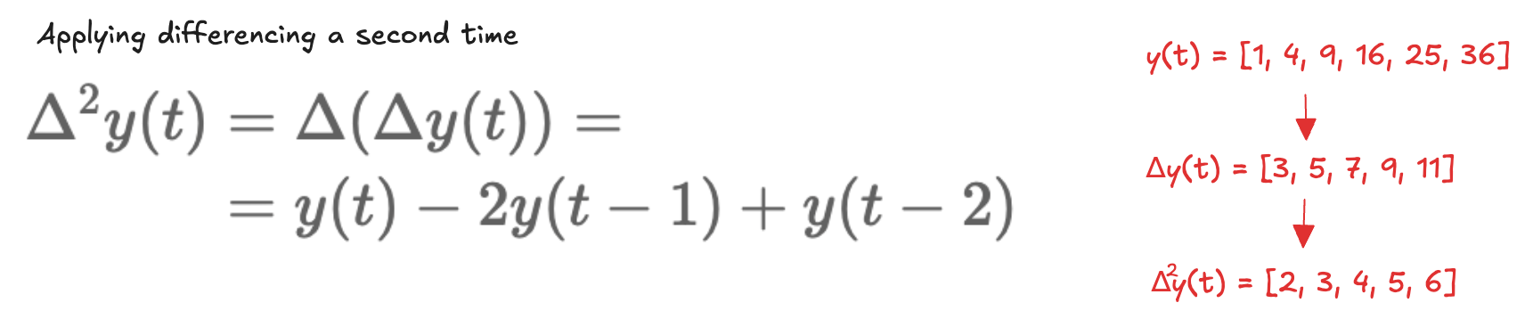
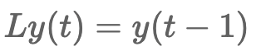
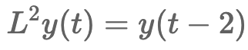
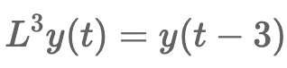
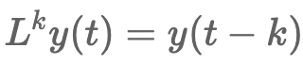
Differencing (2)
If the series follows a quadratic trend, a single round of differencing is not sufficient:
A convenient notation is the lag operator L:
…

Slide 19
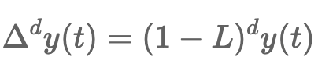
Differencing (3)
Using this notation:
We can use the d-th derivative to remove polynomial trends up to degree d
…

Slide 20
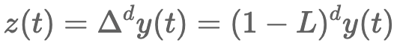
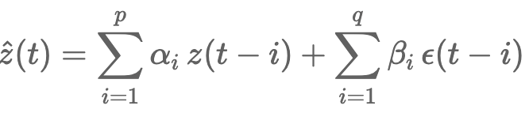
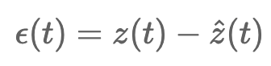
Autoregressive Integrated Moving Average (ARIMA)
Before modelling temporal dependencies, the series is first flattened through differencing so that its statistical properties remain stable over time:
An ARMA model is then applied to the differenced series:
Characterized by three hyperparameters: p and q (as in ARMA), and the additional parameter d, which controls the degree of differencing

Slide 21
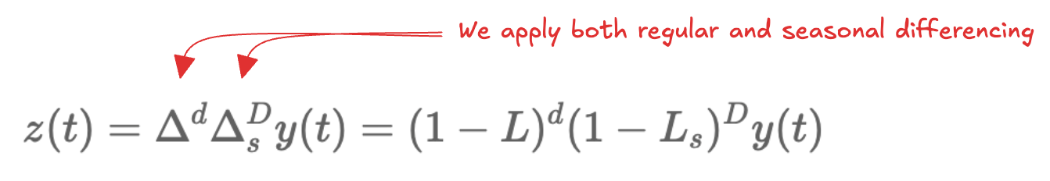
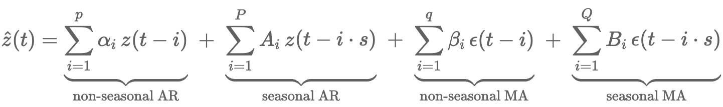
Seasonal ARIMA (SARIMA)
A natural extension, which explicitly accounts for seasonal patterns
Key idea: many time series evolve on different scales simultaneously
a short-term scale, capturing local dynamics from one time step to the next
a seasonal scale, capturing patterns that repeat every s time steps
ARIMA models only the short-term structure, SARIMA augments it by introducing additional autoregressive and moving-average components that operate at the seasonal lag.
Together, these components allow SARIMA to represent both local dynamics and long-range seasonal structure within a unified framework.

Slide 22
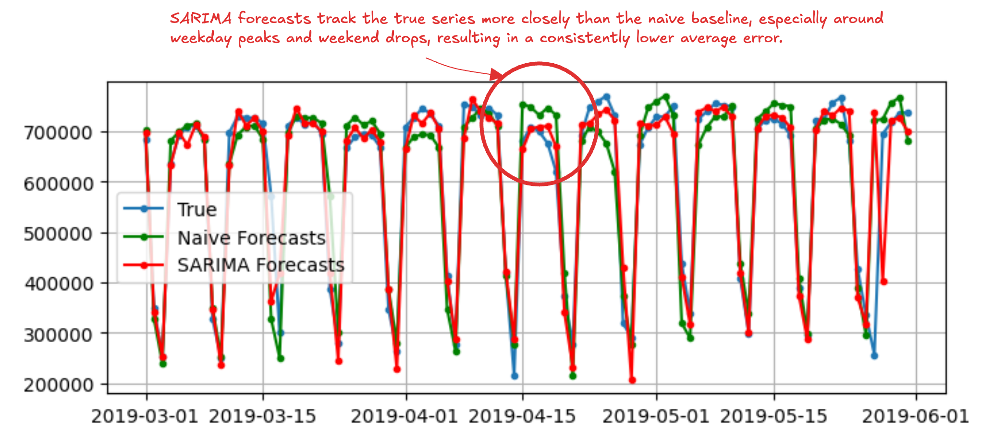
Statsmodels library
Python package for classical statistical modelling and time series analysis
Provide implementations of ARMA, ARIMA, and SARIMA models, along with a wide range of statistical diagnostics and hypothesis tests.
We can exploit this library to fit a SARIMA model to the rail time series:

Slide 23
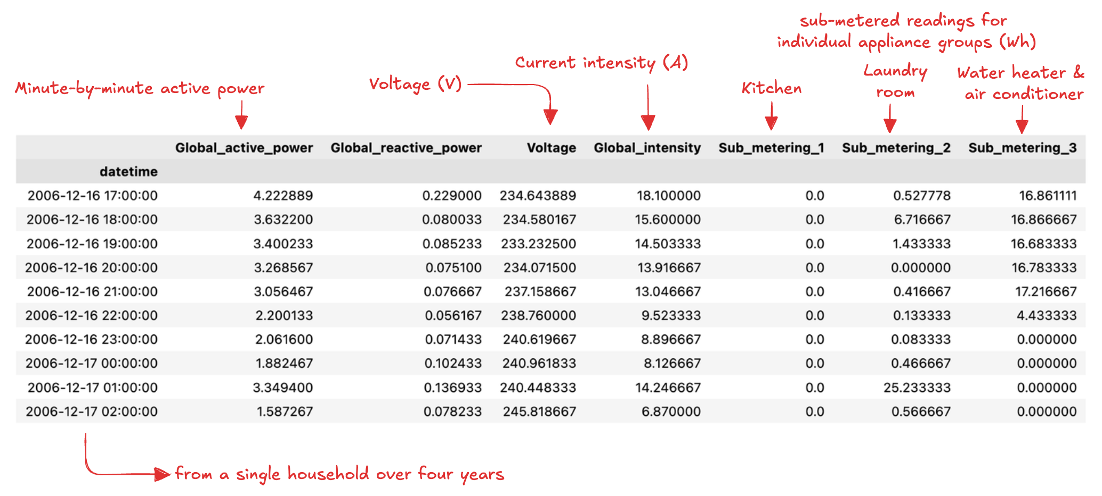
Electrical power consumption dataset (1)
SARIMA performs well on the ridership dataset because the underlying signal is dominated by a single strong seasonality and smooth, stationary dynamics.
We can consider a more challenging engineering problem:

Slide 24
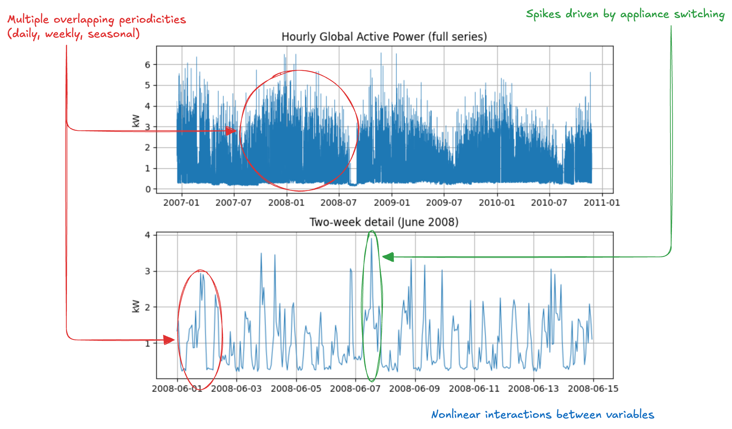
Electrical power consumption dataset (2)
Characteristics fall outside the linear, univariate assumptions of SARIMA

Slide 25
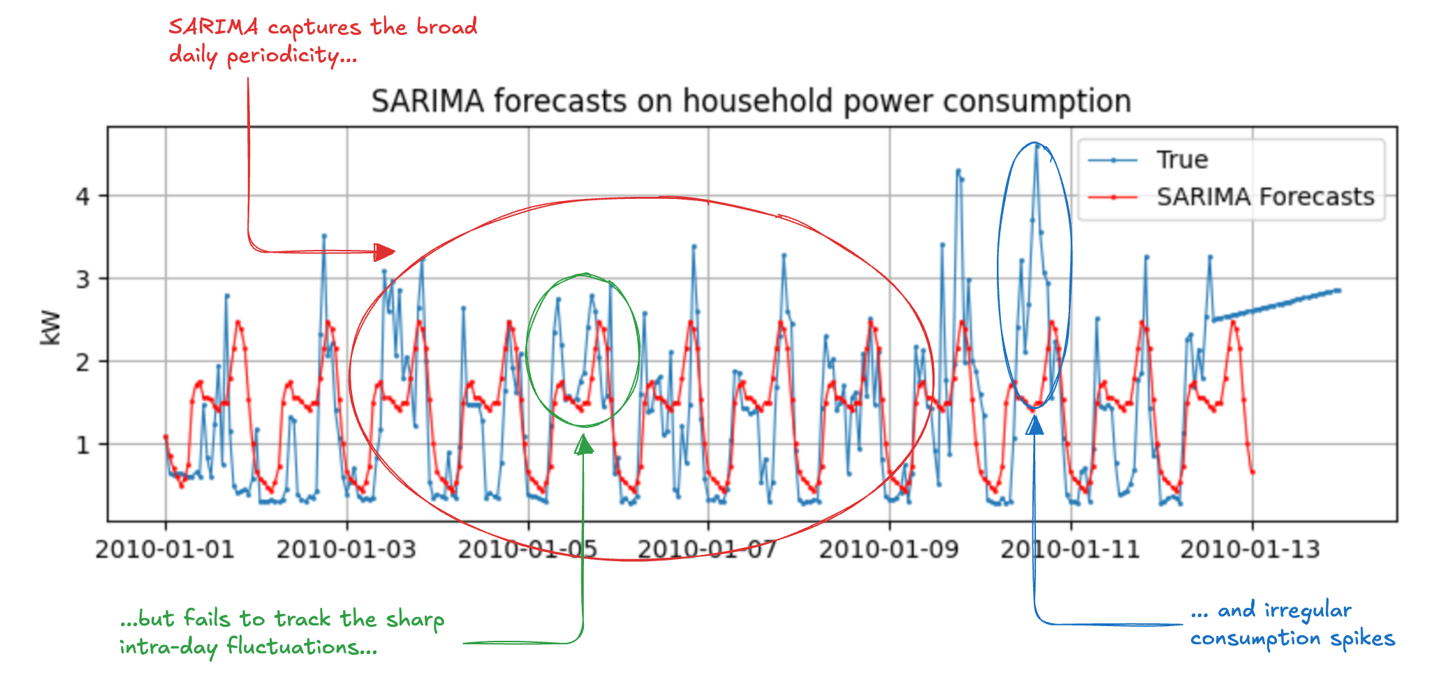
Electrical power consumption dataset (3)
Structural limitation: a linear model with fixed seasonal coefficients cannot represent the nonlinear, state-dependent dynamics

Slide 26
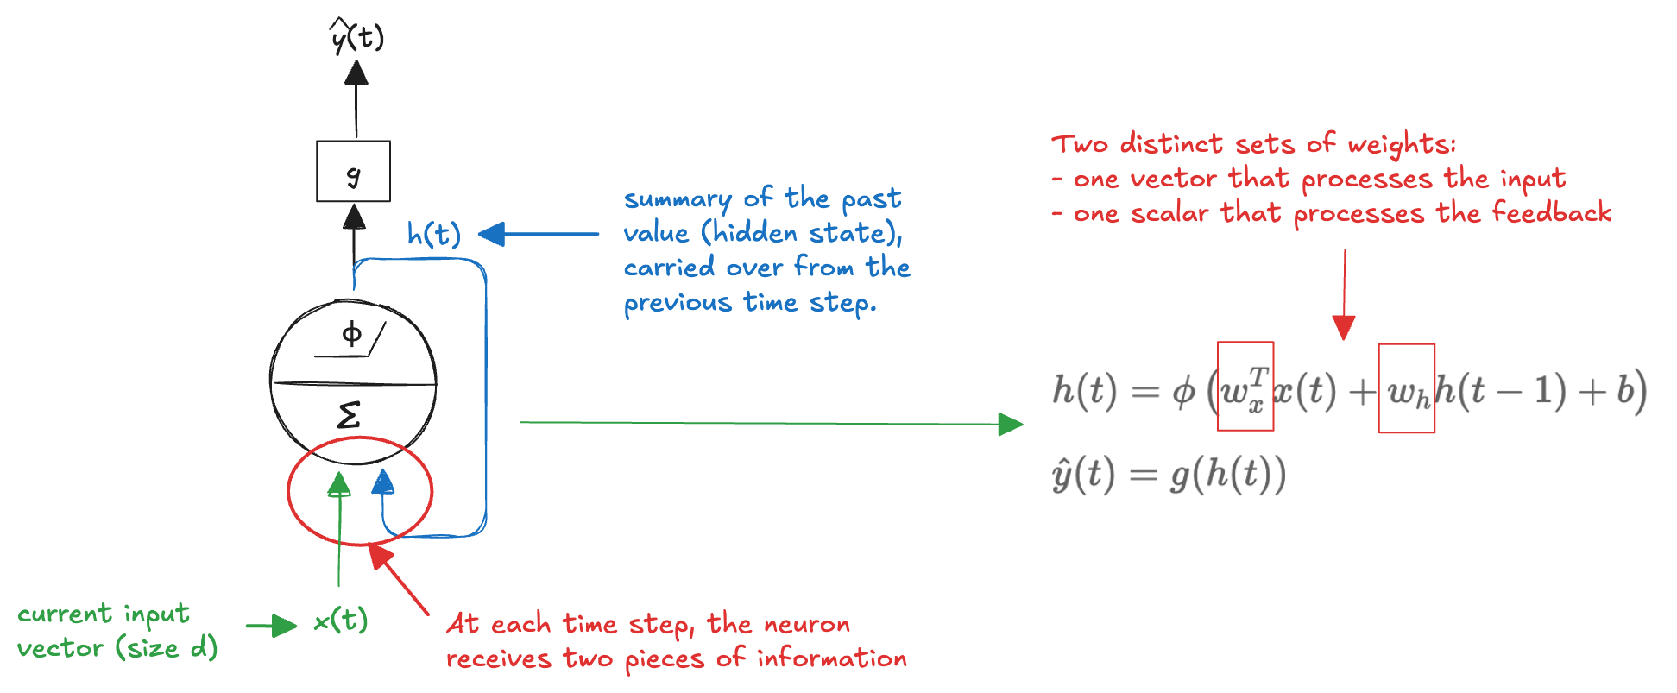
Recurrent Neuron
In feedforward NN, information flows in one direction: from input to the output
Predictions are made independently, without any memory of past inputs
This makes feedforward networks poorly suited for time series
Current value often depends on what happened before
We can address this limitation by introducing feedback connections
The network feeds part of its output back into itself
An internal state that acts as a memory
Recurrent neuron:
The model explicitly captures temporal dependencies

Slide 27
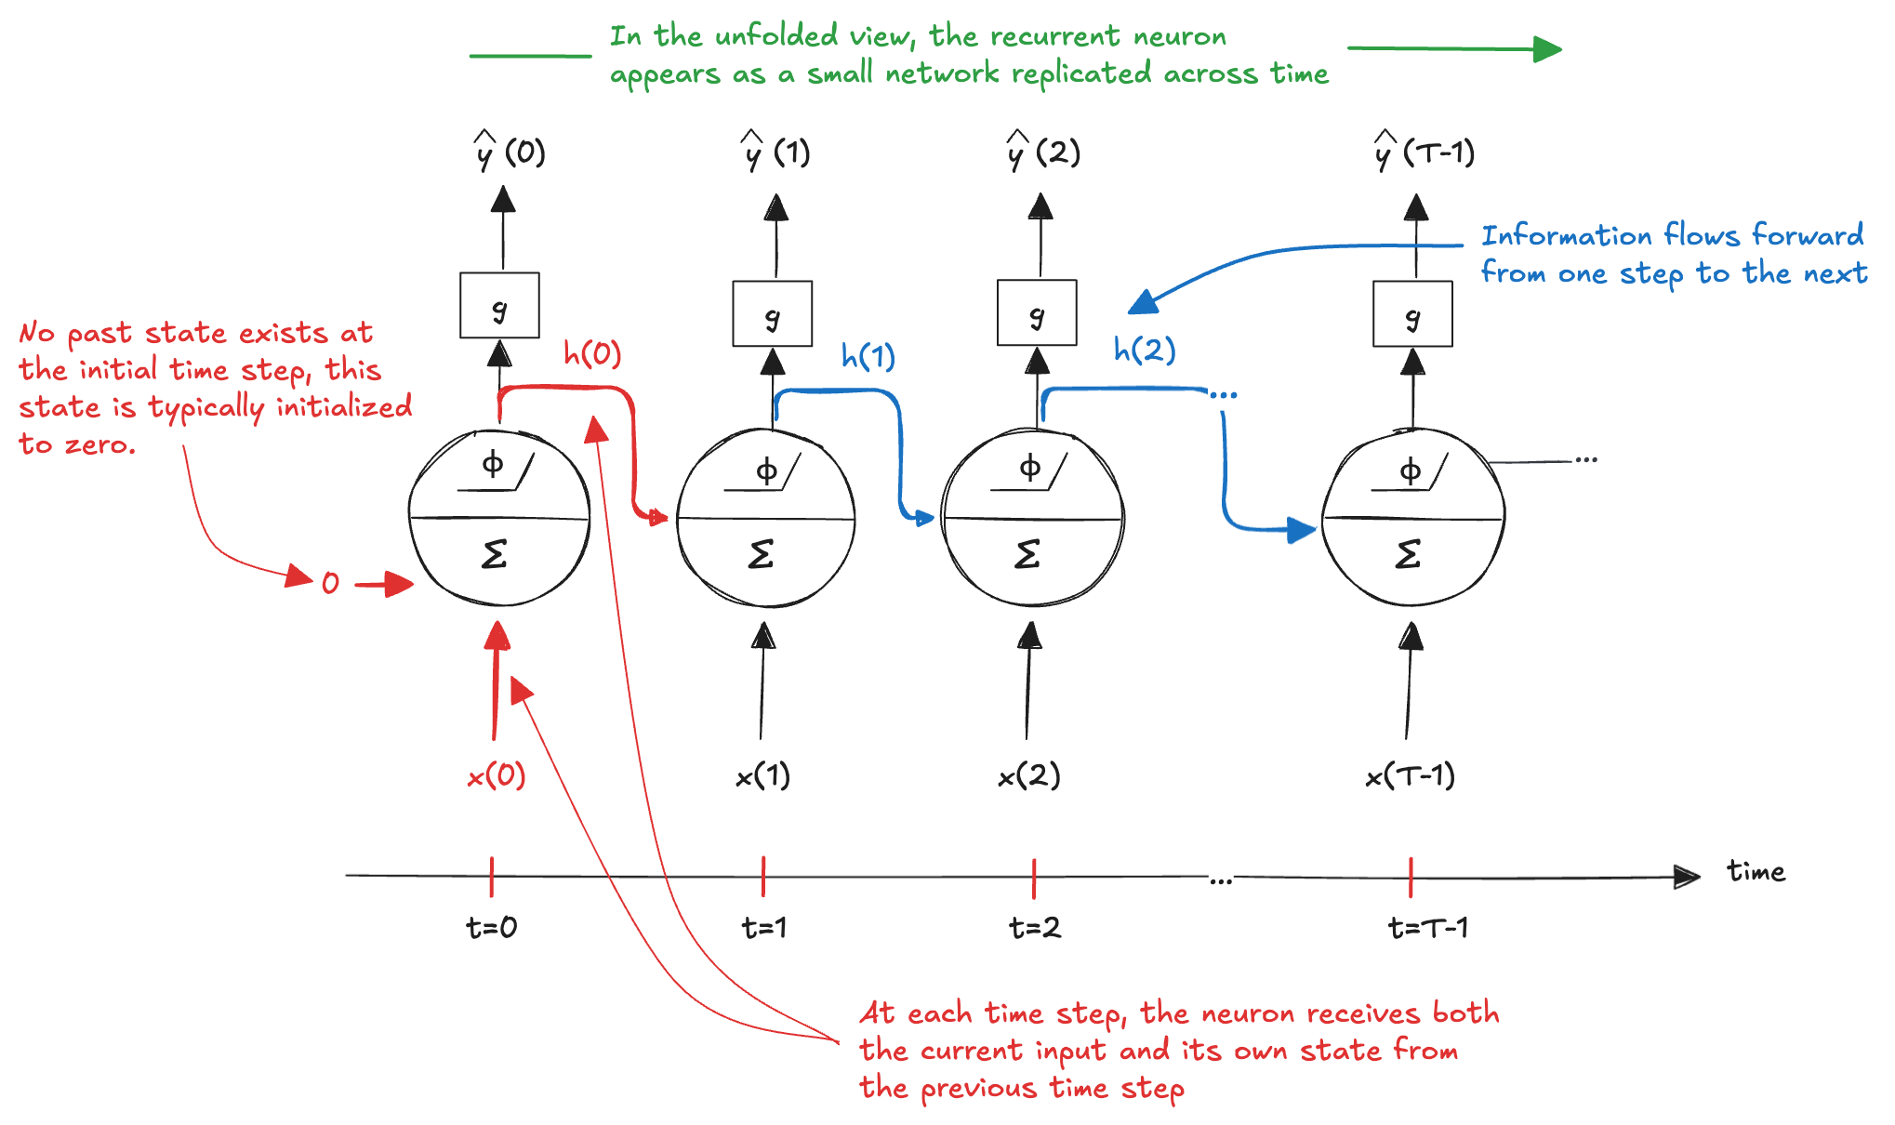
Unrolling through time
The same recurrent neuron is replicated across time steps to explicitly represent how its state evolves:

Slide 28
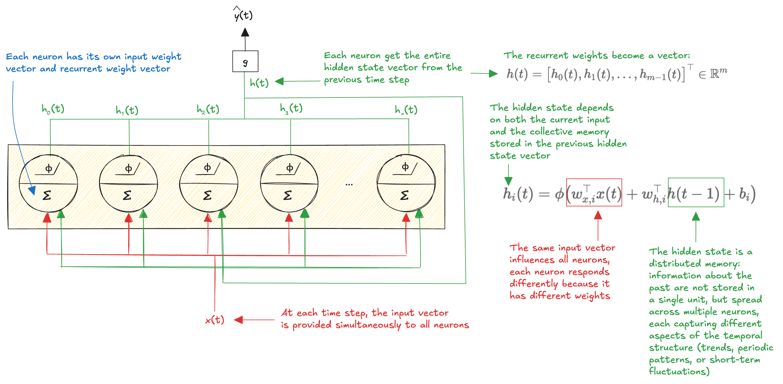
Recurrent Layer
Several recurrent neurons operating in parallel, where the single neuron looks at everything we knew before, not just at its own previous state:

Slide 29
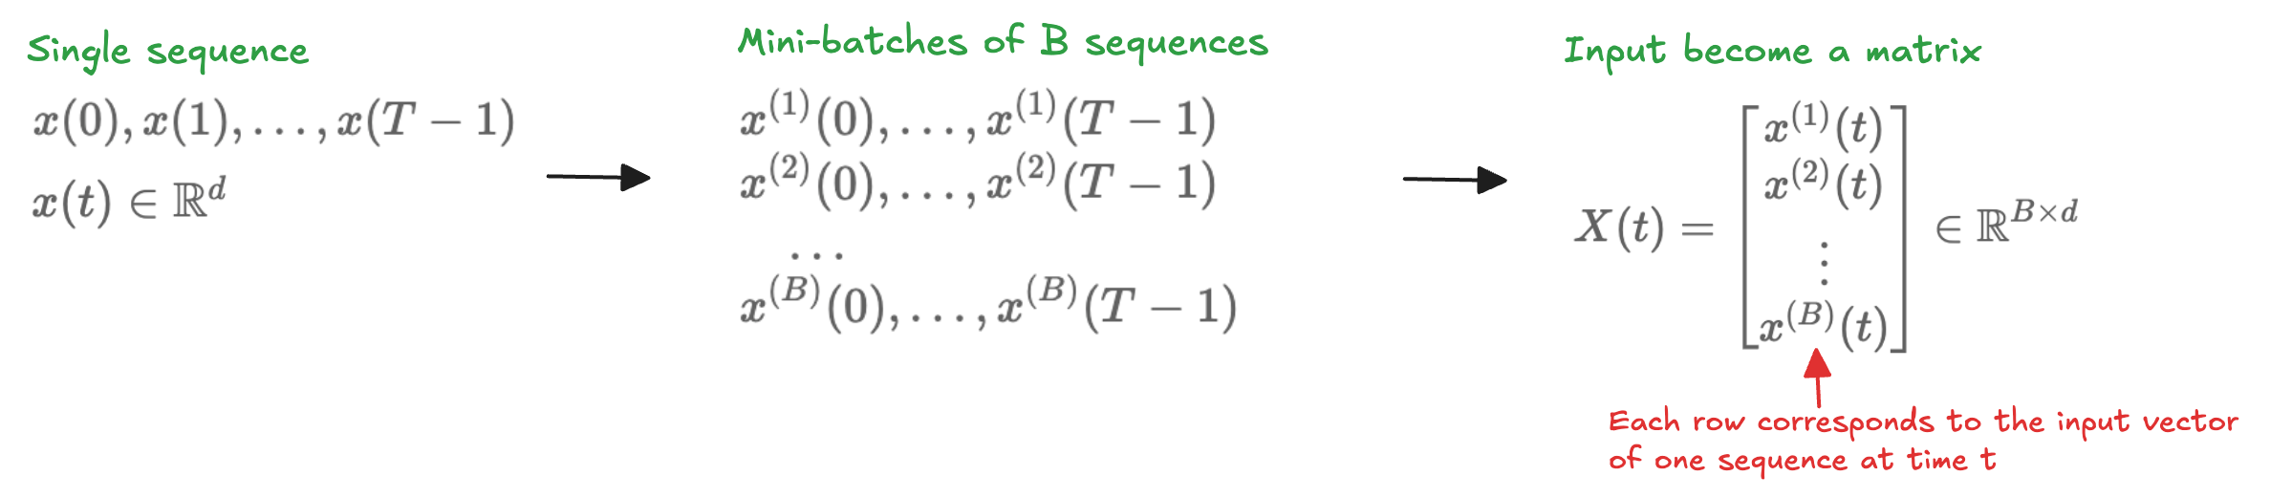
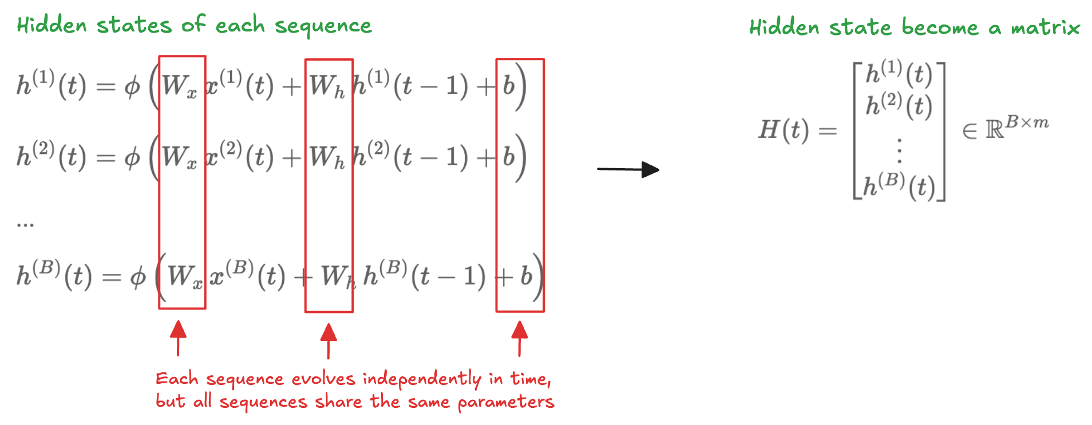
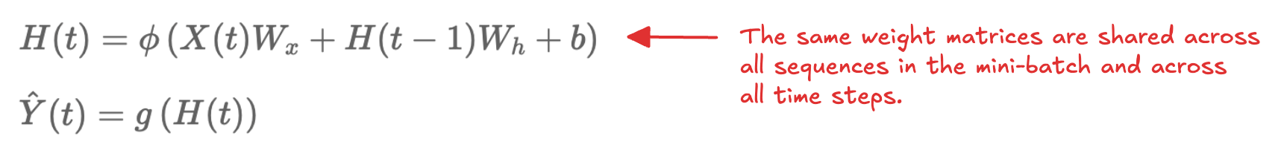
Mini-batches
As for feedforward networks, training use mini-batches:
The hidden state become a matrix:
State update and output are computed simultaneously for all sequences

Slide 30
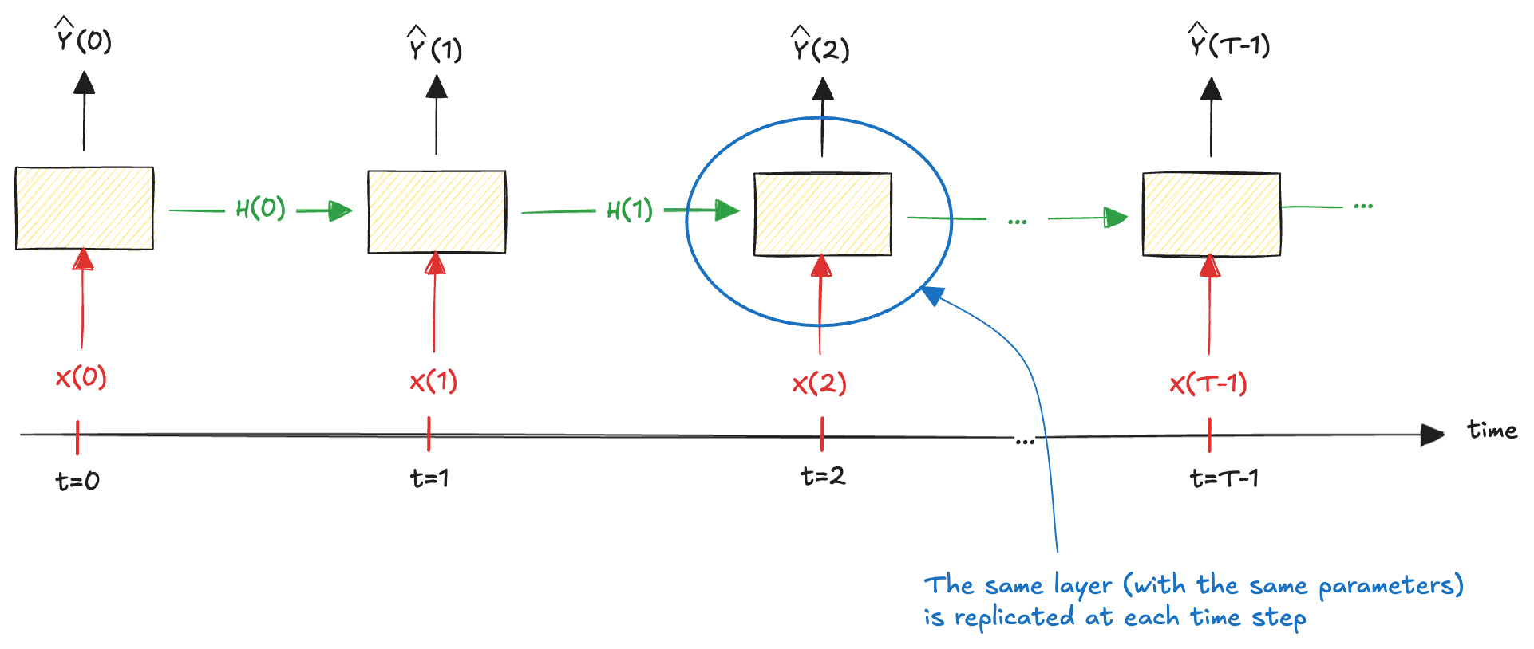
Unrolling through time the layer
As with a single recurrent neuron:
This makes explicit how the hidden state evolves and how information flows forward in time, while emphasizing a crucial property of recurrent networks: parameter sharing across time
Weight matrices and the bias are reused at every time step, allowing the model to process sequences of arbitrary length with a fixed number of parameters

Slide 31
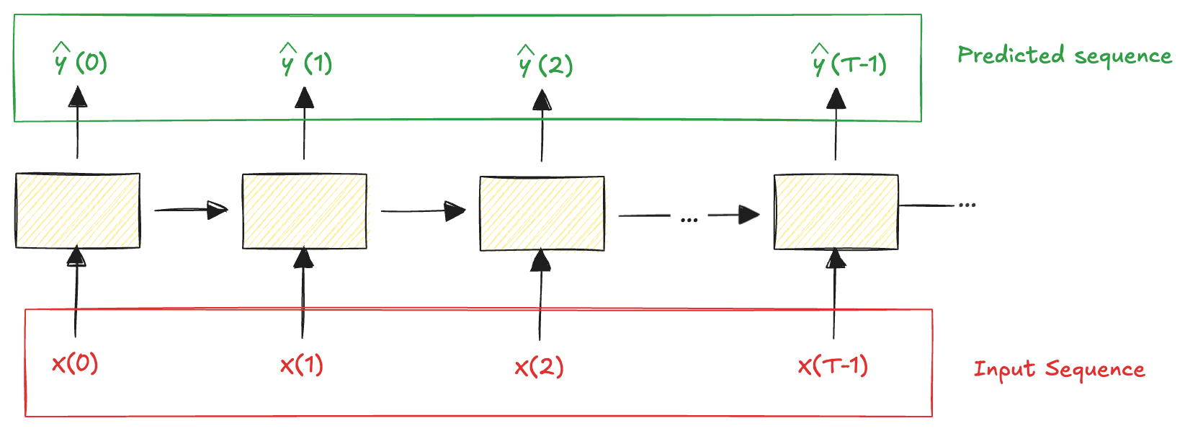
Recurrent Architectures: sequence-to-sequence
Process an entire sequence and produce a corresponding sequence
Example: we feed the network with the household power consumption over the last T days and train it to predict the same sequence shifted one day into the future

Slide 32
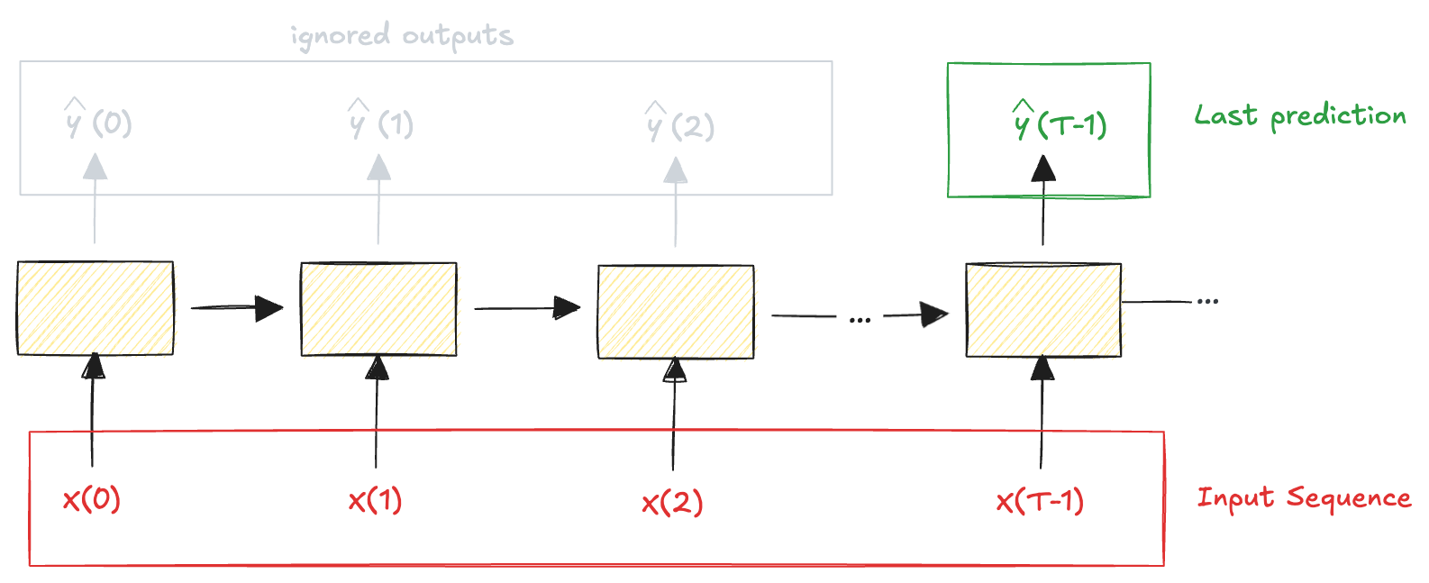
Recurrent Architectures: sequence-to-vector
Feed the network a sequence of inputs and use only the final output
Example: input a sequence of words forming a movie review and output a single sentiment score summarizing the overall opinion expressed in the text
Both architectures can be used to predict values one step into the future; however, they differ in how supervision is applied
sequence-to-sequence: trained to make accurate predictions at every time step
sequence-to-vector: only the final prediction is supervised

Slide 33
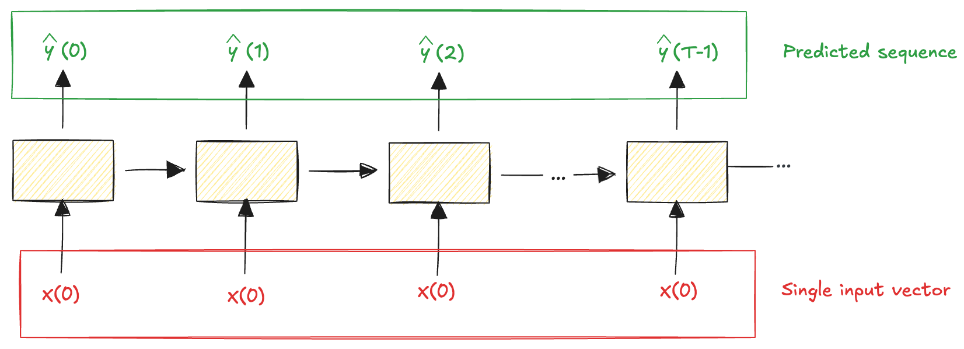
Recurrent Architectures: vector-to-sequence
Provide the network with a single input vector and reuse it at every time step, allowing the network to generate a sequence of outputs
Example: an image is given as input, and the network produces a sequence of words describing the image

Slide 34
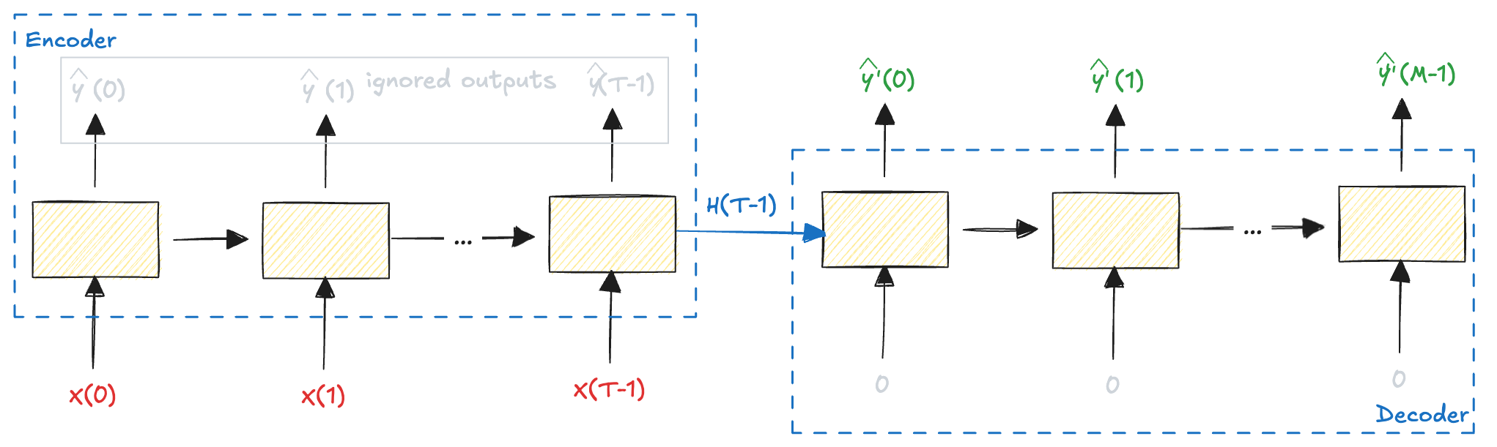
Recurrent Architectures: encoder-decoder
A sequence-to-vector network (encoder), followed by a vector-to-sequence network (decoder)
Example: translating a sentence from one language to another
Notes:
Hands-On Machine Learning with Scikit-Learn,

Slide 35
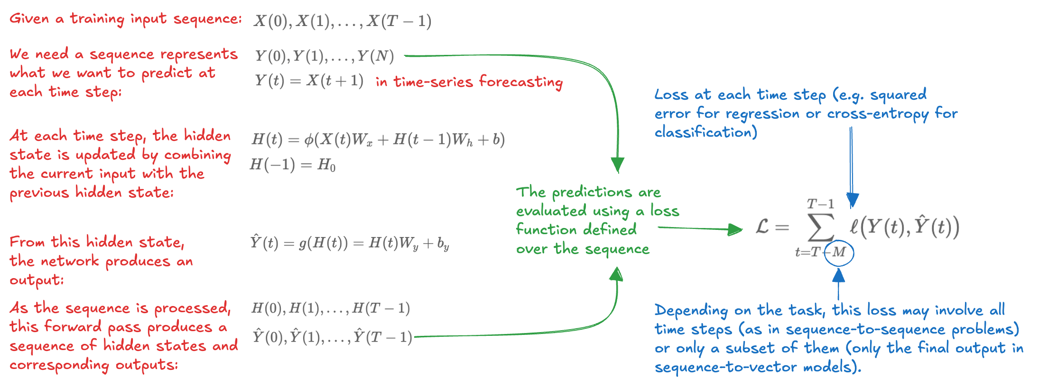
Backpropagation Through Time (1)
Errors does not necessarily originate from current input; it may indicate that relevant information was lost at earlier time steps
During training, the network must learn from the future: errors observed at later time steps should be propagated backward through the sequence to update the parameters used at earlier times

Slide 36
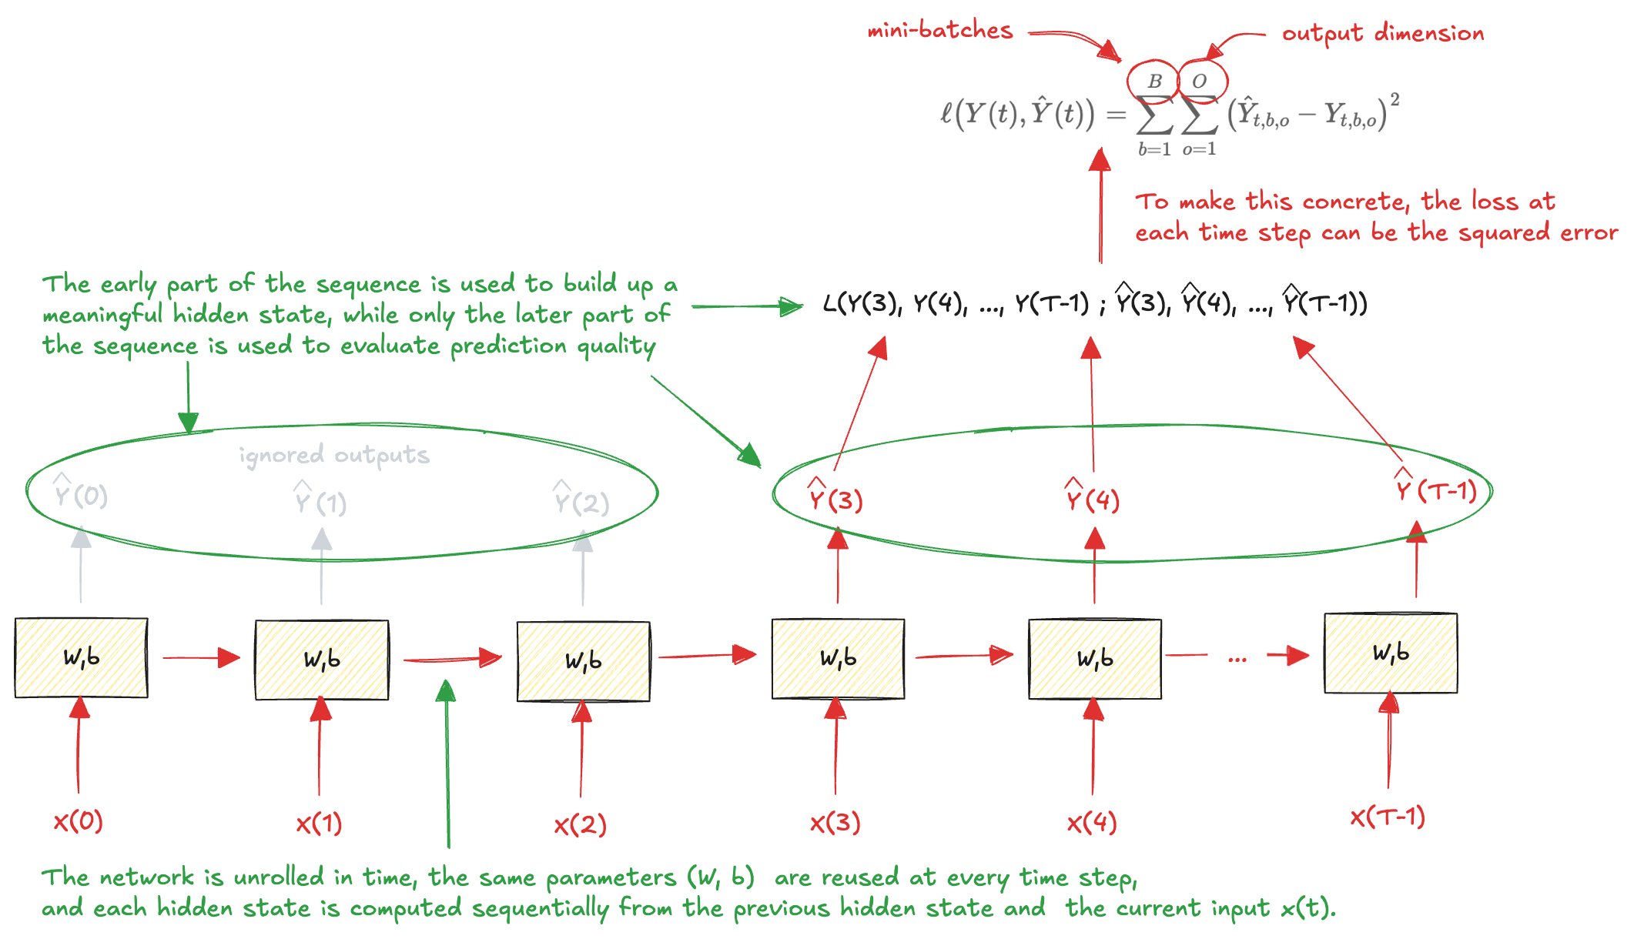
Backpropagation Through Time (2)
Once the loss has been computed, gradients should be propagated backward through the unrolled network

Slide 37
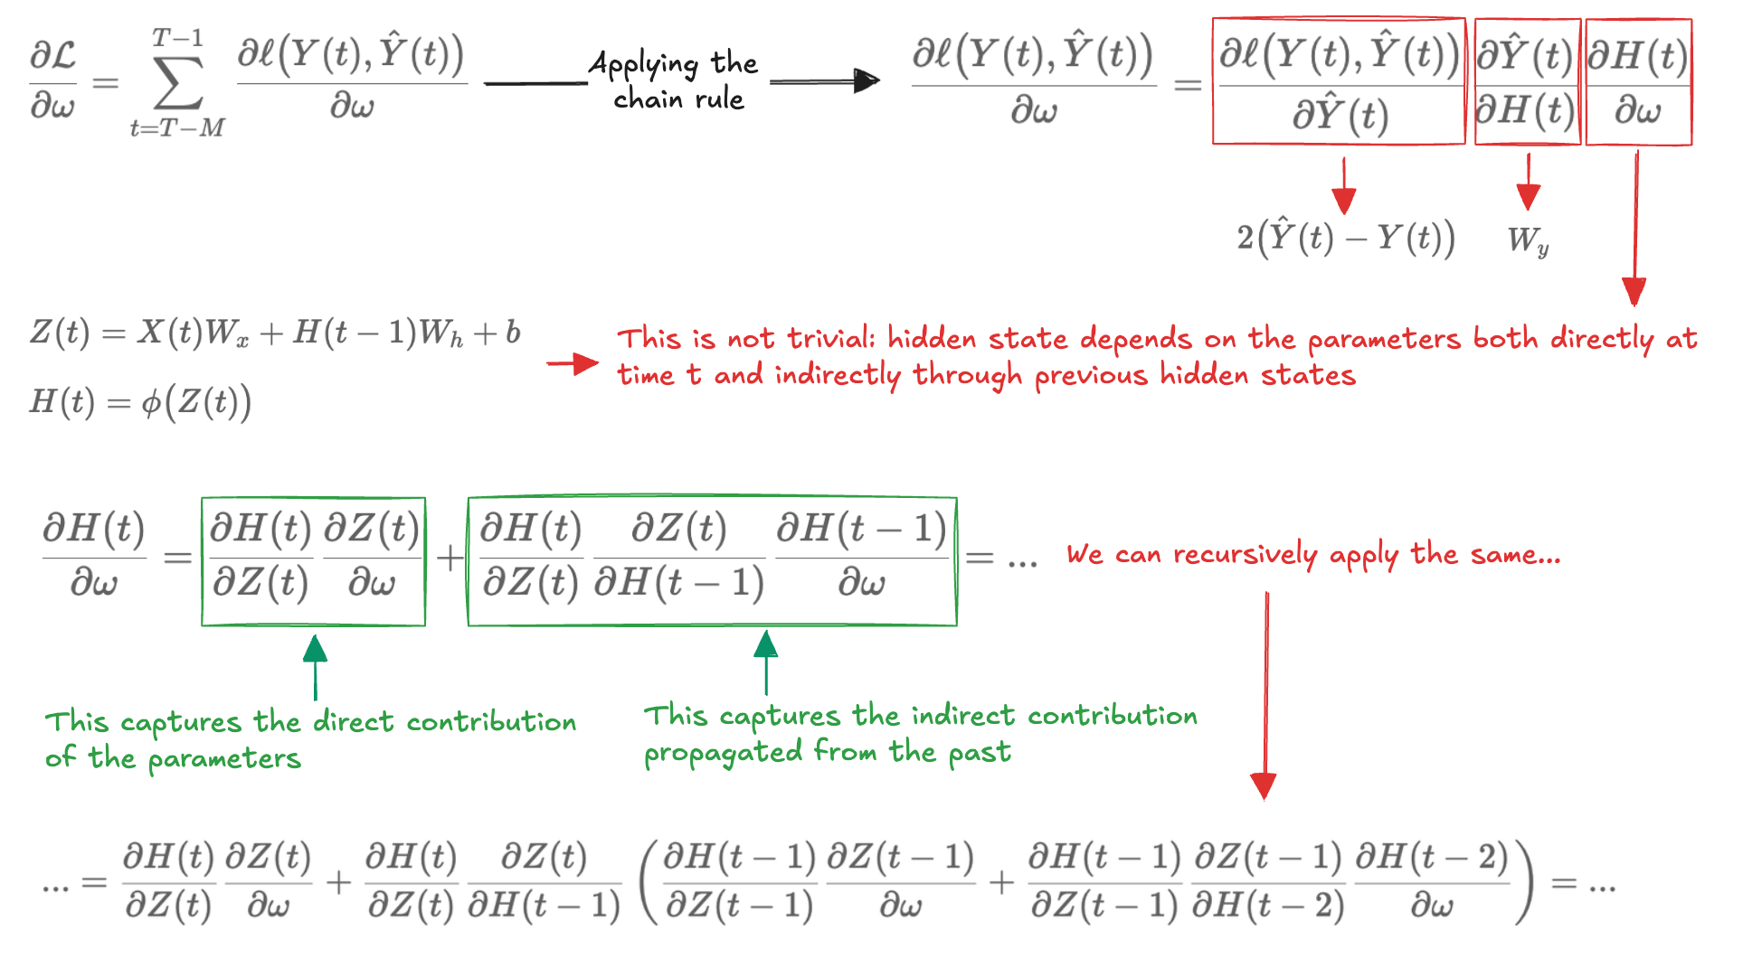
Backpropagation Through Time (3)
To train the model, we need analyse how the loss depends on parameters
The effect of a parameter on the hidden state is obtained by summing its contributions from all previous time steps, each weighted by how changes in the hidden state propagate forward through time

Slide 38

Backpropagation Through Time (4)
The previous derivative is impractical to compute.
Key idea: propagating error signals backward through the network

Slide 39



Backpropagation Through Time (5)
Once the error signals have been computed, the gradients with respect to the model parameters can be obtained by differentiating:
After computing the gradients, the model parameters are updated using SGD:

Slide 40
Truncation length
Sequences can be rather long
Computational problems (too much memory)
Optimization problem (numerical instability)
Input passes through several matrix products before arriving at the output, and others several matrix products are required to compute the gradient
Common practice solution: truncate the unrolling after a fixed number of time steps
Truncation length hyperparameter
A larger truncation length allows the network to capture longer-range dependencies but increases computational cost and memory usage.
A smaller truncation length reduces resource requirements but may limit the network's ability to learn from distant past information.
Balance the need for capturing temporal dependencies with computational efficiency
We can now implement the BPTT in Python for our RNN layer and apply build a model for time-series forecasting

Slide 41


Application to Forecasting (1)
We adopt a sequence-to-sequence architecture
processes a window of historical observations
produces a sequence of one-step-ahead predictions
use a “dense supervision2 across the entire sequence
The time series must first be transformed into input–target sequences
each input sequence consists of the ridership values observed over the past T days
the corresponding target sequence consists of the same window shifted one step into the future
T determines how much historical information the model can exploit:
Large enough to capture the dominant temporal patterns
Not so large as to introduce unstable gradient propagation
A single recurrent layer with 20 neurons followed by a linear output layer

Slide 42

Application to Forecasting (2)
The is noisy, irregular, and driven by complex usage patterns that vary across hours of the day, days of the week, and seasons.
Simple baselines can capture some regularity but struggle with the high variability of the signal
The RNN learns these patterns implicitly from data, which gives it more flexibility but also makes the learning problem substantially harder.

Slide 43

Deep RNN
Increase the representational capacity by stacking multiple recurrent layers:
Higher layers build more abstract temporal features
We can implement it using nn.RNN module of PyTorch

Slide 44

Multivariate time series
Predictions often depend on multiple correlated time series
At each time step, the data are represented by a vector of observations, where each component corresponds to a different variable or feature.
We consider forecasting the rail ridership using both bus and rail as inputs to exploit cross-dependencies between variables when generating forecasts

Slide 45

Recursive multi-step forecasting (1)
Forecast several future time steps simultaneously rather than a single value

Slide 46

Recursive multi-step forecasting (2)
Errors tend to accumulate and the approach is reliable only for short horizons

Slide 47

Direct multi-step forecasting (1)
We can still employ a sequence-to-vector model, but instead of training it to produce a single one-step-ahead prediction, we train the RNN to output the next N values simultaneously in a single forward pass.

Slide 48

Direct multi-step forecasting (2)
This requires a change in the way the dataset is constructed, the targets are no longer scalar values but vectors containing the next observations over the forecast horizon

Slide 49

Sequence-to-sequence forecasting (1)
Instead of training the model to predict the next N values only from the final time step of the input window, the model is trained to generate a full length-N forecast at every time step of the sequence:
This denser and more local supervision both stabilizes optimization and typically accelerates convergence

Slide 50

Sequence-to-sequence forecasting (2)
Different multi-step strategies can be combined
A model to forecast N hours can be applied once to produce an initial forecast and applied again to extend the horizon further
A trade-off between the error independence and ability to reach long horizons
However, all approaches share a fundamental limitation of vanilla RNNs: difficult to capture long-range dependencies

Slide 51
Handling Long Sequences (1)
The main appeals of RNNs is the ability to connect past information to the present task
In video processing, earlier frames can provide context for interpreting the current frame
In many situations only recent context is required.
A language model predicting the next word in the phrase "the clouds are in the ____" does not need to look far into the past: the next word is almost certainly "sky”
In cases like this, RNNs can learn to exploit temporal dependencies effectively
Many tasks require longer-term context.
Predicting the last word in the sentence "I grew up in France […] I speak fluent ____". Recent words indicate that the next token should be the name of a language, but identifying it requires access to information introduced much earlier in the sequence
The gap between relevant information and the point where it must be used can become large
As this gap increases, vanilla RNNs struggle to learn these long-range dependencies

Slide 52

Handling Long Sequences (2)
The network must be unrolled over many time steps, effectively turning the RNN into a very deep computational graph
As with any deep neural network, this depth makes the training process vulnerable to gradients problem

Slide 53

Handling Long Sequences (3)

Slide 54

Saturating activation functions
Exploding gradient is marked using non-saturating activation functions
Simulation: a weight matrix prone to amplification
The tanh activation effectively prevents the hidden state from growing without bound, thus mitigating the exploding gradients problem

Slide 55

Gradient clipping
When implicit control of the activation function is insufficient, it becomes necessary to explicitly limit gradient magnitudes during training
Most common approach: clipping by norm.
preserves the direction of the gradient
while limiting its magnitude
Smaller gradients pass through untouched, so clipping only activates when an update would be dangerously large
Simulation:
train two identical RNNs on the same data:
one using the standard training step and one using gradient clipping
deliberately use a large learning rate to make the training unstable
With clipping, the same learning rate produces a stable and monotonically decreasing loss curve

Slide 56


Batch normalization
Batch normalization:
In RNN the assumption breaks down
Batch normalization cannot be used efficiently with RNNs

Slide 57


Layer Normalization
Like batch normalization, but instead of normalizing across the batch dimension, it normalizes across the features dimension
We can add the normalization to our simple RNN layer
Simulation:
compare hidden state dynamics with and without normalization
use larger recurrent weights to amplify instability

Slide 58
Short-Term Memory Problem
Vanishing gradient:
error signals propagated backward progressively shrink
gradients of distant past inputs decay and become zero
the network cannot assign credit to events that occurred far back
Although relevant information may be present in the distant past, the network is unable to learn how to retain and use it
The model behaves as if it had only short-term memory, regardless of how long the input sequence is
This is not merely an optimization issue, it is fundamentally structural, and requires architectural solutions

Slide 59

Long Short-Term Memory (LSTM)
State is split into two components:
a short-term state H(t), which interacts with the rest of the network
a long-term state C(t), which acts as a persistent memory
The network can learn to control the flow of information by deciding
what to store in the long-term state
what information to discard
what portion of that stored content to expose at each time step.

Slide 60
The long-term state
Think of the long-term state as a structured memory notebook that accumulates information over time
Components correspond to a latent features the network has learned to track (slowly trend, a seasonal phase, or a contextual condition)
Example:
We are modelling daily electricity consumption in a building
Over many days, the LSTM has learned to encode in one component whether the building is in a "winter heating regime"
In another component whether it is in a "weekday operational mode”
These pieces of information are not directly observable; they are internal abstractions encoded in different coordinates of the cell state

Slide 61

The Forget gate
What information we’re going to throw away from the long-term state
Example:
Spring arrives
Temperature and short-term state signal the heating regime is no relevant
The forget gate computes for this component a value close to 0: "that feature is no longer useful, suppress it"
The forget gate allows the LSTM to control the effective time scale of each latent feature

Slide 62

The input and candidate gates
What new information deserves to be written into long-term memory
Example:
Activation of an air-conditioning system due to an unexpected heatwave
Input contains high temperature, hidden state summarizes recent load
A candidate vector with a coordinate that encode "cooling regime activation"
The input gate decides where writing is appropriate

Slide 63

Updating the state
What portion of internal memory should influence the network’s behaviour at the current time step
Example:
The outside temperature is high, the cooling-related component of the state becomes critical for forecasting
The output gate assign a coefficient close to one to that coordinate
The slow annual trend component is less informative for short-horizon prediction, so the gate may attenuate it

Slide 64

LSTM in action
We implement LSTM using PyTorch
To highlight the ability of the LSTM to exploit longer-range dependencies, we increase the input window from T to a larger value

Slide 65

Gated Recurrent Unit (GRU)
A simplification of the LSTM architecture
Instead of maintaining the two separate state variables, it collapses them into a single vector.
Idea: a single state can simultaneously act as internal memory and as the quantity exposed to the rest of the network
We can use PyTorch to implement a GRU with minimal changes to LSTM code

Slide 66

1D Convolution (1)
LSTM and GRU often struggle when dependencies extend across hundreds or thousands of time steps
Idea: apply convolution!
A set of learnable filters (kernels)
Slide along the temporal axis
Computes local weighted sums

Slide 67


1D Convolution (2)
If the kernel size is small, the layer captures short-term micro-structure.
If we stack multiple layers, the effective receptive field increases.
Depth builds hierarchical temporal abstractions
Two hyperparameters strongly affect behaviour: stride and padding

Slide 68

WaveNet architecuture
This is not sufficient!
To model a 16 kHz audio waveform, even a few hundred milliseconds correspond to thousands of time steps
Capturing such long-range structure with ordinary convolutions would require either very large kernels or extremely deep networks
WaveNet addresses this by introducing two key ideas: causality and dilation

Slide 69

WaveNet in action (1)
On time series with strong weekly periodicity LSTM and WaveNet tend to perform comparably
WaveNet's architectural advantage becomes visible only when dependencies span very different temporal scales simultaneously and local context alone is genuinely insufficient
A compelling example is the electrocardiogram (ECG)
the sharp spike lasts a few milliseconds
the full cardiac cycle spans roughly one second
a baseline drift evolves over several seconds

Slide 70

WaveNet in action (2)
In one-step-ahead forecasting the next sample is always close to the current one and LSTM's local memory suffices
A different task is autoregressive generation
the model predicts one step ahead
feeds that prediction back as input, and repeats over several seconds
Any model that has not internalized the true temporal structure will quickly lose the rhythm and collapse to a flat line.
This is like the recursive multi-step forecasting (same mechanism). The difference is the intent: the goal is not to predict the exact millivolt value, but to generate a plausible ECG

